Slide 1

Chapter 1
An Overview of Statistical Concepts

Slide 2
Why do we need biostatistics?
We have lots of questions that need answers.
  Childhood obesity
  Cancer
  Infectious disease
  Issues specific to an aging population
  Exposures to environmental toxins
We need strategies for answering the questions.

Slide 3
Why do we need biostatistics?
Variety is the spice of life (and statistics and research).
Suppose all subjects were exactly the same, responded to medications all in the same way, had the same compliance to treatment, and had the same mortality risks.
Practicing public health would be pretty boring.

Slide 4
Why do we need biostatistics
We attempt to answer research questions by conducting studies.
  Biostatistics provides us with strategies for investigating important questions even when the subjects are diverse.
  Biostatistics is really the science of summarizing and handling the variability that comes from doing research on a diverse group of subjects.

Slide 5
Research Questions
The goal of public health practice is to try to improve health.
One area of public health concern is childhood obesity.
  Research question: What causes childhood obesity?
  Is this easy to answer?
  How do we go about answering this question?
Notes:
Teaching note: It may be helpful to begin this slide by asking students to provide examples of research questions they are interested in. Have the students notice that some are broadly defined and some are very specific. As an active learning opportunity have the students translate their research questions into testable statements (hypotheses).

Slide 6
Biostatistics Terms
Hypotheses: Translating research questions into testable statements.
Data: Information that is collected to provide evidence for/against the hypotheses.
Inference: Conclusions that are made about the hypotheses using the data. Is there enough evidence to support/reject claims?

Slide 7
Learning Objectives
How do I get the subjects?
What variables do I measure?
How do I describe the data?
How do I estimate the parameter?

Slide 8
Public Health Application
A study is conducted to better understand childhood obesity.
Children between the ages of 6 and 10 who attend public schools are given questionnaires and clinical exams.
Questionnaire: Participation in school lunch programs, activity level, the amount of television watched, and video games played.
Clinical exam: Height, weight, and body mass index (BMI) .
A total of 610 children participate in the study.
Notes:
Teaching note. This is the example that will be used throughout the chapter and the presentation. It can be used to bring students back to the research question and the purpose of the statistical methods being discussed.

Slide 9
Populations and Samples
What Subjects to Study

Slide 10
Who or What?
The subjects of interest in a research question are
  Children
  Extracted teeth
  Water sources exposed to bacteria
  Cell cultures
  Households in the tropics
  Women with osteoporosis
  Student athletes
  Homeless teenagers
In our research question about childhood obesity, who or what are the subjects of interest?

Slide 11
Population
The population is all the subjects of interest.
What is the population for the study on childhood obesity?
  How is it defined?
  Is it clear who the subjects are?
  Is this a reasonable population given the research question?

Slide 12
Collecting Data on the Population
To investigate the research question, we need information on the subjects.
One way to do this is to collect data on all the subjects in the population—to conduct a census.
  When would it be important to conduct a census?
  Is it practical to conduct a census to investigate childhood obesity?
  What other options do we have?

Slide 13
Samples
An alternative to collecting information on all the subjects in a population is to collect information on a piece or a subset of the population.
A sample is a subset of subjects from the population.
  How could a sample be used to investigate the research question?
  What problems could arise when using a sample instead of the entire population?

Slide 14
Bias in Sample Selection
Samples that systematically miss a portion of the population are considered biased.
The way samples are chosen can lead to bias.
  Voluntary response
  Convenience samples
How can samples be chosen so that bias is minimized?

Slide 15
Random Chance
Samples chosen using random chance reduce bias in sample selection.
  Random number tables are tables of numbers that have been randomly generated from a computer.
  Random number generators are available on most computers and can provide a list of random numbers.

Slide 16
Random Number Tables
A table of random digits is a list of the digits 0, 1, 2, 3, 4, 5, 6, 7, 8, and 9 that have the following properties:
    The digit in any position in the list has the same chance of being any one of 0 – 9.
    The digits in different positions are independent in the sense that the value of one has no influence on the value of any other.

Slide 17
RANDOM NUMBER GENERATOR
Notes:
Instructors: It is helpful to demonstrate random number generators in class. Several options exist using Excel, SAS, R, and even on-line applets.

Slide 18
Choosing a Random Sample
Sampling frame
  Is a list of the subjects in the population
  Provides a “menu” of the subjects to be sampled
Use random chance (generator or number table) to select subjects for the sample.
  Simple random samples
  Stratified random samples
  Systematic random samples

Slide 19
Summary
An important part of defining the research question is defining the subjects.
Generally, the population is too large to use to collect data for the research question.
Samples can be selected from the population.
  It is hard to avoid bias in sample selection.
  Planning and using random chance can go a long way toward reducing bias in sample selection.

Slide 20
Study Designs
How to study the subjects

Slide 21
Studying the Subjects
Variables are items measured on the subject.
  Height
  Weight
  BMI
  Activity level
  Number of hours watching TV or playing video games
In research studies, there is usually one variable of primary interest: the outcome or the primary endpoint.
The other variables measured in the study are used to explain the outcome.
What is the outcome for investigating childhood obesity?

Slide 22
Three Popular Designs
Prospective:
  Outcome found at the end of the study
  Selects the subjects and then follows them to see what outcomes occur
Retrospective:
  Outcome found at the start of the study
  Selects the subjects with particular outcomes and then looks backward to see what variables are different for those with and without the outcome
Cross-Sectional:
  Only one time point
  Variables and outcomes are measured at the same time
Notes:
Teaching note: Students should be able to determine the type of study design used in the PHA. As an active learning opportunity, have the students considered the pros and cons of implementing each of these designs to study childhood obesity. What do they think is the best (and most feasible) approach?

Slide 23
Variable Types
What to measure on the subjects?

Slide 24
Variable Types
Continuous
Categorical:
  Ordinal
  Nominal
  Dichotomous
Count

Slide 25
Numerical Summaries
How to describe the subjects

Slide 26
Common Numerical Summaries
Numerical Summary | What it Does
Continuous variables
Mean | Describes the center of measurements
Variance | Describes the spread of measurements
Median | Describes the middle/center of measurements
Range | Describes the spread of measurements
Categorical variables
Count | Describes the number of subjects with the category
Proportion | Describes the number of subjects with the category out of all subjects

Slide 27
Parameters and Statistics
Parameters are numerical summaries that describe the population.
  They do exist.
  We do not know what they are.
  We have to denote them with symbols (not numbers or values).
Statistics are numerical summaries that describe the sample.
  They do exist.
  We do know what they are and can calculate them from the data in the sample.

Slide 28
Notation
Parameters and statistics use different notation because they describe different sets of subjects.
The notation is similar because they refer to the same type of numerical summary.
Numerical Summary | Notation | Meaning
Population mean | μ | Mean of a variable measured on the population
Sample mean |  | Mean of a variable measured on the sample
Population proportion | P | Proportion of subjects in the population with the category
Sample proportion |  | Proportion of subjects in the sample with the category

Slide 29
Graphical Summaries
How to describe the subjects

Slide 30
Distributions
Distribution
  Provides the possible values
  Provides the number of subjects with those values
    Frequency distribution provides the count of subjects.
    Probability distribution provides the proportion of subjects.
Distributions can be provided
  In tables (numerical)
  With histograms and bar charts (graphical)

Slide 31
Distribution of Activity Level
Activity Level Categories | Count of Participants | Proportion
Very active | 78 | 0.13
Moderately active | 101 | 0.17
Somewhat sedentary | 252 | 0.41
Very sedentary | 179 | 0.29

Slide 32
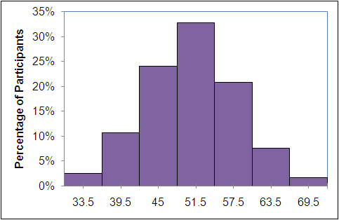
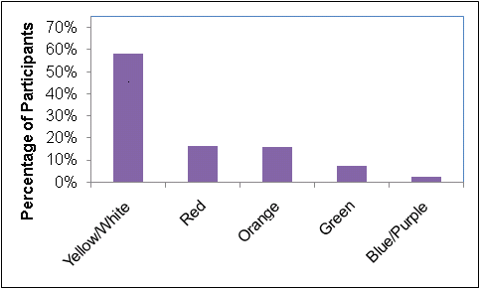
Common Graphical Summaries
Categorical Variables
Continuous Variables
Bar Graphs
Histograms

Slide 33
Distributions
Distributions provide information on
  Symmetry
  Location of center and spread
  Evidence of patterns
Some distributions have special shapes.
  The normal distribution has one peak, is symmetric, and has the mean and median in the center.
  A skewed distribution has longer tails in one direction.

Slide 34
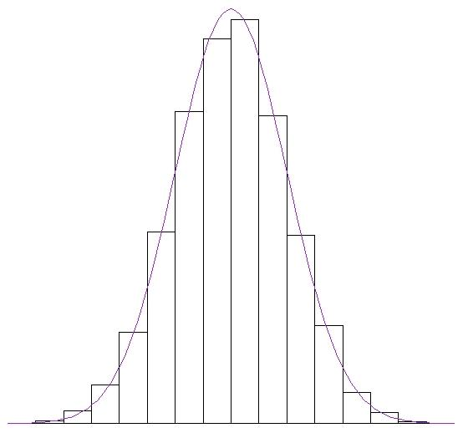
Normal Distribution
Point of Curvature
(One Standard Deviation)
Mean and Median

Slide 35
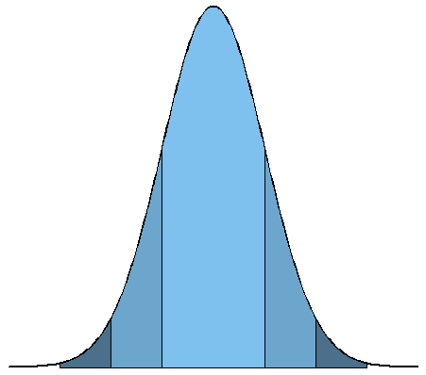
The Empirical Rule
[----68%---]
[-----------95.4%---------]
[-----------------99.7%-----------------]

Slide 36
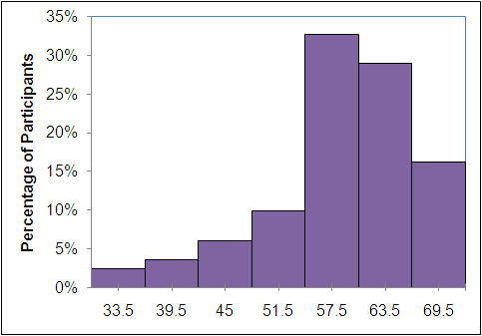
Skewed Distributions
Skewed distributions have longer tails in one direction.
  Right-skewed distributions have a longer tail to the right.
  Left-skewed distributions have a longer tail to the left.

Slide 37
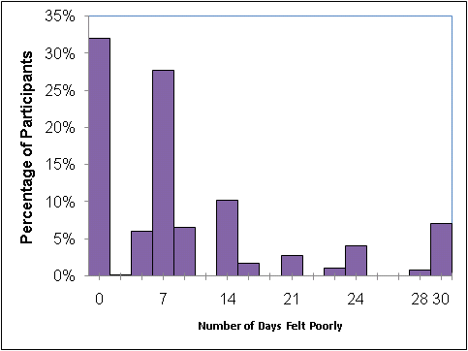
Count Variables
Count variables are special.
  Can go to infinity.
  Gaps in between possible counts.
  Mean and variance are the same.
  Distribution is often skewed to the left.
Depending on the number of counts measured, a variable can be summarized as a continuous or categorical variable.

Slide 38
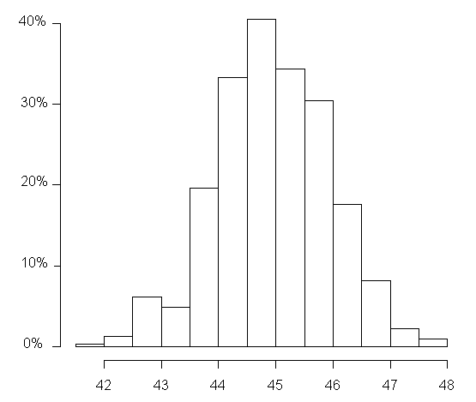
Percentiles
Percentiles are the percentage of observations that have values smaller than the one of interest.
  Heights come from a normal distribution with mean of 45 in. (SD 1 in.)
  Distribution can be used to
  determine if a child’s height
  is very short, very tall, or
  average.

Slide 39
Online Calculators Available
Normal distribution
t-distribution
F-distribution
Binomial distribution
Chi-square distribution

Slide 40
Variability

Slide 41
Variability Within Subjects and Samples
Reliability:
  The variability that comes from measuring the same subject multiple times is described with reliability.
Sample variance:
  Samples are composed of different subjects.
  The variability that comes from measuring different subjects in a sample is described with the sample variance.

Slide 42
Sampling Variability
Samples are composed of different subjects.
If different samples of different subjects are taken, do you expect to get the same results?
Sampling variability refers to the fact that samples of different subjects result in different results.

Slide 43
Sampling Distributions
When random samples are selected over and over again, the statistics from these samples will have a particular distribution—a sampling distribution.
The Central Limit Theorem tells us that the sampling distribution of means is normally distributed.

Slide 44
Sampling Distribution for the Mean
Point of Curvature
All Possible Sample Means

Slide 45
Test Statistics
Not all statistics will come from a sampling distribution that is normally distributed.
  Variances come from Chi-square distributions.
  Ratios of variances come from F-distributions.
The formulas for statistical test are often just transformations of statistics into test statistics that come from a well-defined distribution.

Slide 46
Concepts for Statistical Inference

Slide 47
Estimation
Statistics are used to estimate the parameter.
  Sampling variability means that the statistics from different samples will be different.
  Can we trust the statistic we found to estimate the parameter?
Confidence intervals are interval estimates that can estimate the parameter.
  Take the sampling variability into account.
Notes:
Teaching note: I like to give students a visual example of why point estimates are problematic. I draw a point on the board and have an object that is the same size. I ask the students to tell me if they think they will be able to hit the point on the board with an object that is the same size. It is pretty tough to do (if they say they can hit, I let them try—no one has hit that dead on). Then I ask the students if they threw something larger, could they hit the point. I ask them to consider tossing the chair or the desk. They all agree that their chances are much better with using something larger. This is the idea behind confidence intervals.

Slide 48
Confidence Intervals
The sampling distribution is centered at the true parameter.
Most statistics will be near the true parameter.
  We just need to add a little to each side of the point estimate to make it large enough to cover the true parameter.
  Adding and subtracting the margin of error make the point estimate an interval estimate that is likely to cover the true parameter.

Slide 49
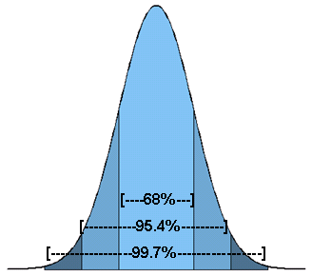
Confidence Interval Example
The sampling distribution of the mean.
95% of all sample means will be within about two standard deviations from the center.
A 95% confidence interval is
found by adding and
subtracting about two
standard deviations.

Slide 50
Hypothesis Testing
The purpose of a statistical test is to assess the evidence provided by the data against some claim about a parameter.
A hypothesis is a claim about the parameter.
Hypotheses are concerned only with the population.
  Null hypothesis
  Research hypothesis

Slide 51
Null Hypothesis (H₀)
A statistical test begins by supposing that the effect we want is not present.
  Goal of the study is to find evidence against this claim.
The claim that we are trying to find evidence against is called the null hypothesis.
  No effect
  No difference
  Status quo
We want to assess the strength of the evidence against the null hypothesis.

Slide 52
Research Hypothesis (H₁)
The statement we hope or suspect is true is called the research hypothesis.
If there is enough evidence, we can reject the null hypothesis in support of the research hypothesis.

Slide 53
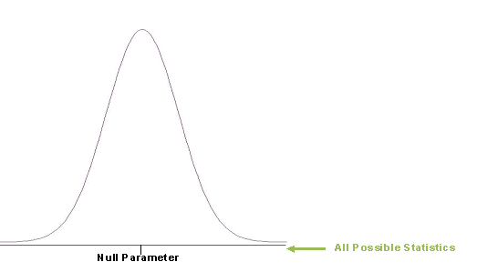
Hypothesis Testing
We assume that the null hypothesis is true.
  It usually means we are assuming that some guess of the parameter (null parameter) is the true parameter.
  The sampling distribution is centered at the null parameter.

Slide 54
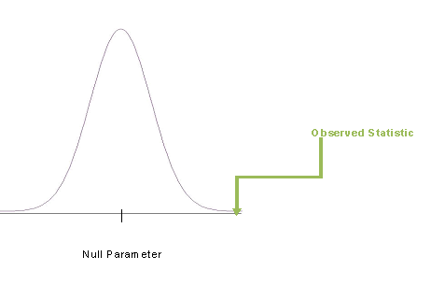
Hypothesis Testing
If the statistic we observed is far enough away from the null parameter, then that is evidence against the null hypothesis.

Slide 55
How far away do you need to be?
A p-value is defined as the probability of getting a statistic more extreme than what you observed.
A p-value is the percent of less “expected” statistics.
If the p-value is small, then there is an evidence that the null hypothesis may not be true.
  Generally, a p-value smaller than 5% is considered small.

Slide 56
Why 5%?
The “small enough” cutoff is called the significance level.
Common significance levels are
  0.001
  0.01
  0.05
  0.1
You want the cutoff to be small enough so that you do not incorrectly reject the null hypothesis.

Slide 57
Errors and Power
There are two types of errors that can be made when performing hypothesis tests.
Type 1
  Rejecting the null hypothesis when you should not
  Type 2
  Not rejecting the null hypothesis when you should
Ideally, you want to have a good chance of rejecting the null hypothesis when you should (power).

Slide 58
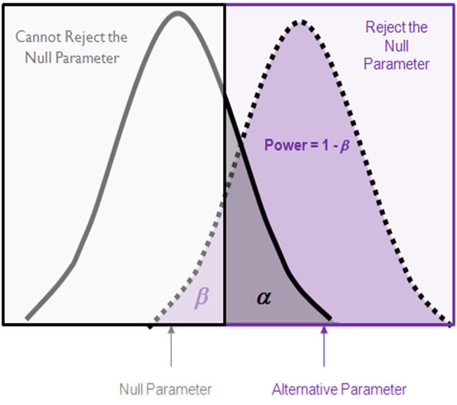
Notes:
Note that as the sample size increases, the precision in the estimates also increases, which makes the sampling distributions skinnier. It makes it easier to discern between the two distributions.

